Slide 1

Data Analysis and Visualisation System
Algorithms and Data Structures
Completed by Anvar Khalmuratov

Slide 2

Problem Statement: The Quest for Efficient Data Management
In today's data-driven world, the ability to store, retrieve, and analyse vast amounts of information efficiently is paramount. This project addresses the critical need for a system capable of handling these challenges with speed and precision.
Efficient Data Storage and Analysis: Managing large datasets requires intelligent structures to optimise storage and retrieval.
Fast Searching, Sorting, and Grouping: Rapid access to specific data points, organised sequences, and aggregated information are core requirements for effective data handling.
Analysis of Algorithm Performance: Understanding the efficiency of different algorithms is crucial for selecting the most appropriate solutions for various computational tasks.

Slide 3

Comprehensive Data Structures Utilised
Our system employs a diverse array of data structures, each chosen for its specific strengths in handling different data organisation and retrieval scenarios. These foundational elements ensure both efficiency and flexibility.
Linear Structures
Fundamental for sequential data access.
Array
1
Stack
Queue
Deque
Circular List
Associative Structures
Designed for key-value pair storage and quick lookups.
2
Hash Tables
Map
Set
Tree Structures
Hierarchical organisation for efficient searching and sorting.
3
Binary Search Tree (BST)
AVL Tree
Red-Black Tree
Trie
Specialised Structures
Optimised for unique computational demands.
4
Heap
Bloom Filter
Segment Tree
Fenwick Tree

Slide 4


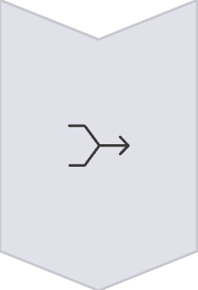

Exploring Sorting Algorithms
Efficient sorting is a cornerstone of data processing. This project implements and compares a range of sorting algorithms, from basic to advanced, highlighting their operational differences and performance characteristics.
Simple Sorts
Bubble, Selection, Insertion Sort: Ideal for small datasets due to their straightforward logic, but less efficient for larger volumes.
Efficient Sorts
Merge, Quick, Heap Sort: Utilise divide-and-conquer strategies or tree-like structures for significantly better performance on larger datasets.
Specialised Sorts
Counting and Radix Sort: Non-comparison sorts that can achieve linear time complexity under specific conditions, often for integer data.
"The true measure of an algorithm's elegance is its efficiency when handling the unwieldy."

Slide 5




Effective Search Algorithms Implemented
Locating specific data within a collection is a frequent operation. Our system incorporates various search algorithms, each offering different performance characteristics depending on the data's structure.
Linear Search
Binary Search
A simple, brute-force approach that checks each element sequentially until a match is found. Suitable for unsorted or small datasets.
Highly efficient for sorted arrays, rapidly narrowing down the search space by repeatedly dividing the list in half.
Hash Table Search
Leverages hash functions to directly compute an index, providing average O(1) time complexity for lookups, making it extremely fast for large, dynamic datasets.

Slide 6
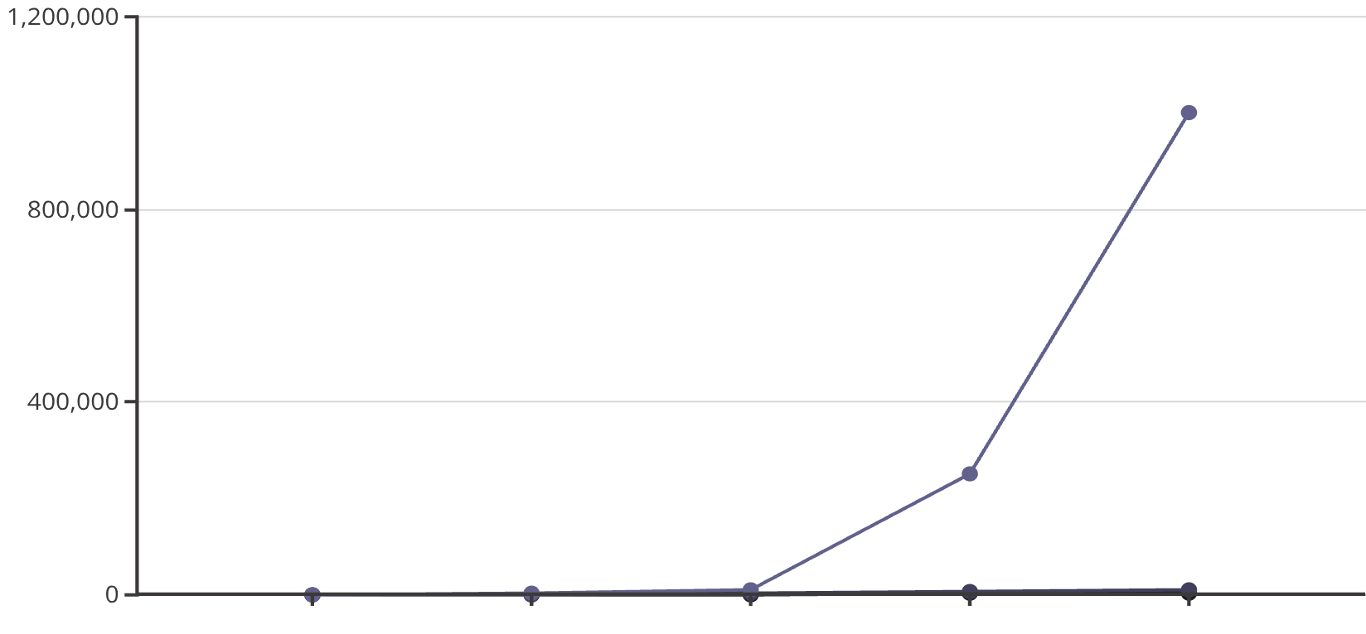
Complexity Analysis: Understanding Algorithm Performance
A crucial aspect of algorithm design is understanding its efficiency. We delve into time and space complexity using Big-O notation to rigorously evaluate and compare the performance of various algorithms.
Time and Space Complexity (Big-O notation): This mathematical notation describes how the runtime or space requirements of an algorithm grow as the input size increases. It provides a high-level understanding of performance bottlenecks.
Comparison of O(n²) and O(n log n) Algorithms: We contrast algorithms with quadratic complexity (e.g., simple sorts) against those with more efficient logarithmic-linear complexity (e.g., Merge Sort, Quick Sort), demonstrating the significant performance gains achievable with optimised approaches, especially for large inputs.
Input Size (n)
O(n log n) Time
O(n^2) Time
Efficient Algorithms for Large Datasets: The project emphasises the selection and implementation of algorithms that maintain scalability and responsiveness even when confronted with massive data volumes.
This chart illustrates the significant performance difference between O(n log n) and O(n²) algorithms as the input size (n) increases.

Slide 7




Project Architecture & Practical Demonstration
The system is built with a clear, modular architecture, ensuring maintainability and scalability. We will demonstrate its capabilities through practical examples using real-world data.
Modular Project Structure
The system is designed with independent modules for each data structure and algorithm, promoting code reusability and ease of debugging.
Data Loading from CSV
Data is efficiently loaded from CSV files, showcasing the system's ability to handle external data sources and prepare them for analysis.
Demonstration of Algorithms Execution
A live demonstration will illustrate the execution of various algorithms on loaded data, providing visual insights into their operational behaviour and performance.

Slide 8

Conclusion: A Comprehensive and Practical Solution
This project successfully delivers a robust data analysis and visualisation system, fulfilling all course requirements and providing a practical platform for understanding fundamental algorithms and data structures.
All Required Components Implemented
Practical Demonstration of Behaviour
A comprehensive suite of linear, associative, tree, and specialised data structures, alongside a variety of sorting and searching algorithms, have been successfully integrated.
The system provides clear, tangible evidence of how algorithms operate in real-world scenarios, allowing for direct observation of their efficiency.
Meets All Assignment Requirements
From theoretical understanding to practical implementation and performance analysis, the project meticulously addresses every aspect outlined in the course brief.

